Slide 1

Wellcome
This project showcases core data structures in action through an efficient Warehouse Management System.
Md. Sadiqul Huq Hemal
Id: 242-45-805
Batch: 43 Section : K

Slide 2

Sadiqul Himel
Warehouse Management System
C Language Implementation with Multiple Data Structures

Slide 3
Introduction
& Objective
Simplify warehouse operations in a single interface
Manage inventory, shipments, and orders efficiently
Track changes with undo functionality
Developed in C language
Handles products, shipments,and orders
Includes undo history and dashboard view
Present clear, tabular data views

Slide 4
Key Data Structures
Array | Product inventory storage
Linked List | Shipment tracking
Queue | Order processing
Stack | Undo history

Slide 5
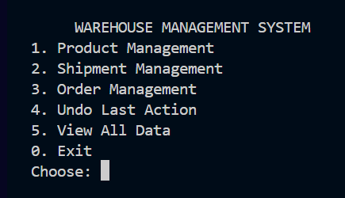
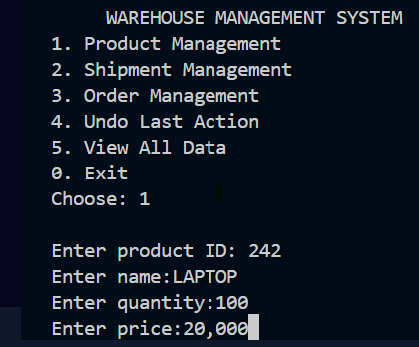
System Workflow
Add product
Place order
stored in array
stored in queue
Add shipment
View dashboard
stored in linked list
shows all data in tables
Undo
removes last change from stack

Slide 6

Main Features
Track shipments
Manage orders
Undo recent actions
Add & display products
using linked lists
via a queue system
stack-based
with duplicate ID check

Slide 7



Sadiqul Himel
Advantages
system’s structure
Efficiency
usability
Simple, fast, and organized data handling
Clear tabular output for readability
Modular functions for easy maintenance

Slide 8
Impact in Day-to-Day Life
Business Use | Time-Saving | Error Reduction | Educational Impact
Helps warehouses track stock, shipments, and orders without errors | Reduces manual paperwork and speeds up operations | Prevents duplicate entries and provides undo option | Demonstrates practical use of data structures in C

Slide 9
Sadiqul Himel
Future Improvements
Auto-update inventory
Enhanced input validation
Edit options in UI
Maintain accurate stock levels automatically
Prevent invalid or negative data entries
Allow quick corrections and updates to records

Slide 10
Conclusion
Reduces manual work by automation.
System Achievements
Products in Warehouse
Successfully manage
Organized data with clear tabular outputs.
Warehouse Management System
Shipments and Orders
Fast access to key nformation.
Current Strengths
Future Vision
Undo safety for recent actions
Scalable System
Reliable,Acurate and user-Friendly
Auto Update Inventory
Planned Improvements
UI enhancements
The Warehouse Management System streamlines inventory, shipment, and order handling with speed and accuracy.
Its safety features and modular design ensure reliability, while planned upgrades will make it scalable for real-world use.
Enhanced input checks

Slide 11
Sadiqul Himel
Thank you all for your attention.
If there’s any question or clarification needed, I’m happy to answer.

